Slide 1
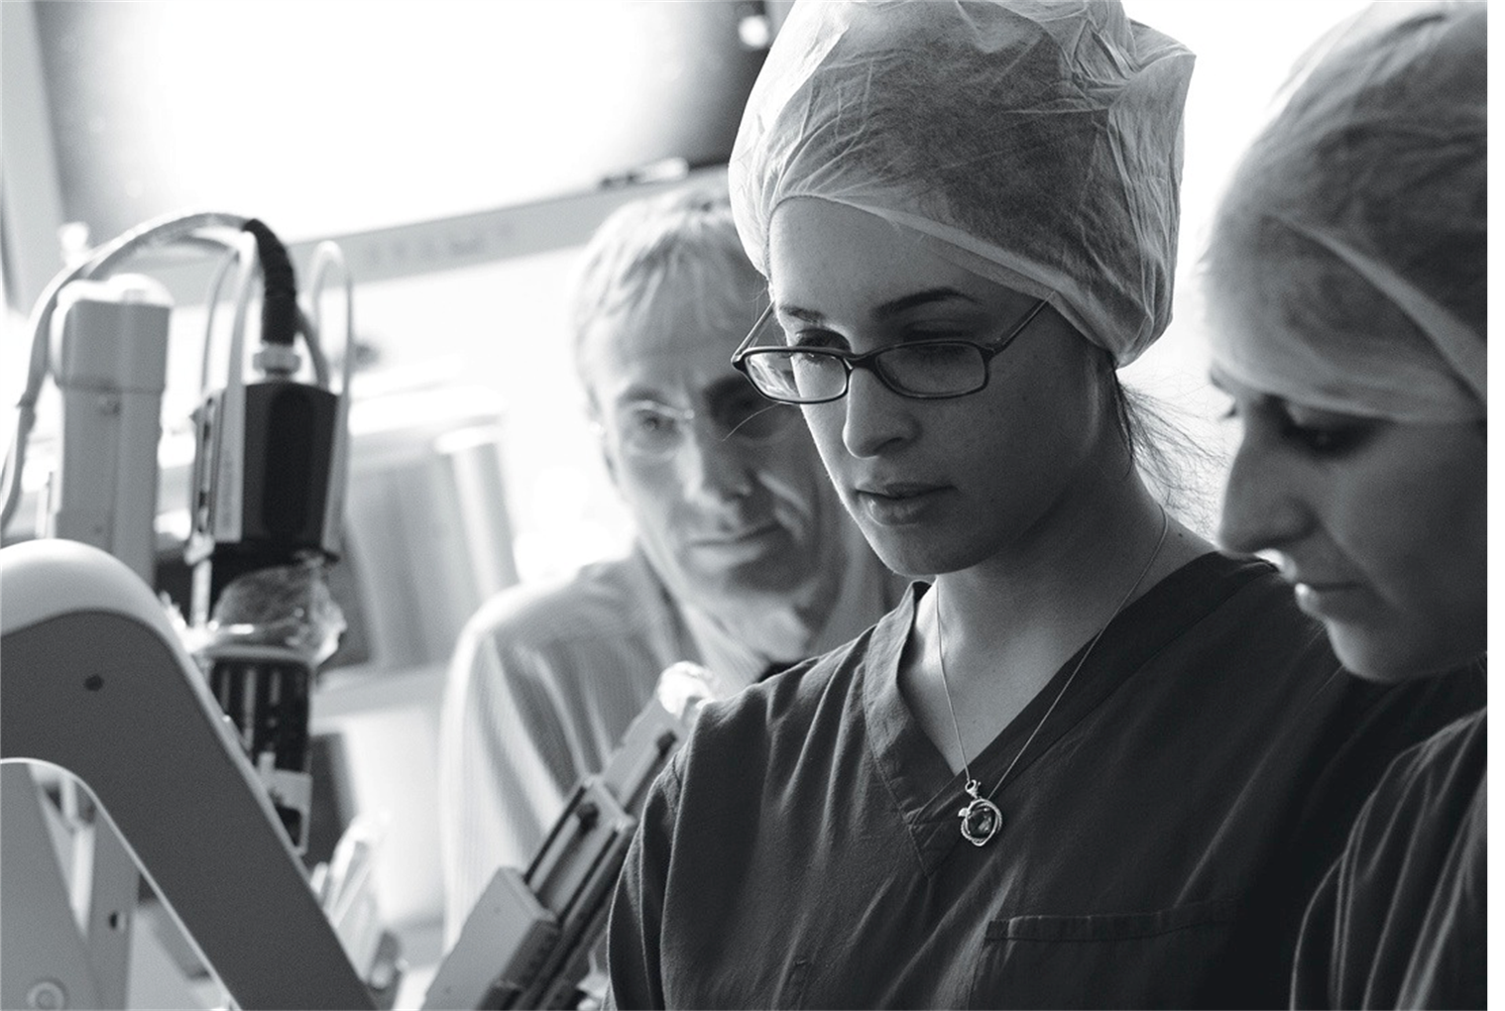

Canadian Resident Matching Service
(CaRMS)
November 22, 2016
Office of Student Professional Development (OSPD)
Notes:
This presentation is intended to provide introductory information for Canadian students interested in the Canadian Resident Matching Service.

Slide 2


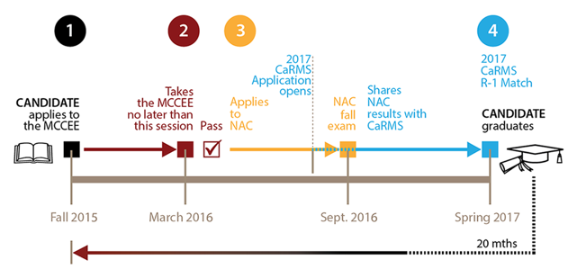
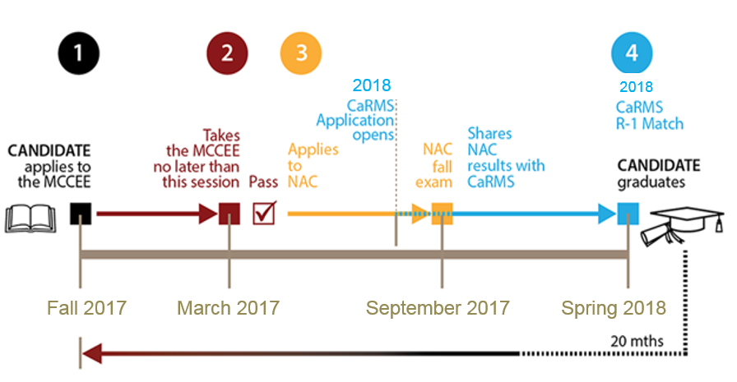

CaRMS 2018 R-1 Match Timeline
MCC - PHYSICIANS APPLY
( www.mcc.ca )
( www.physicansapply.ca )
(All exams which lead to licentiate from MCC)
The LMCC is a part of the Canadian Standard, the set of requirements for awarding a full license. Upon receiving their LMCC, candidates are also enrolled in the Canadian Medical Register.
Notes:
We will discuss the different components of a CaRMS application and the corresponding timeline.

Slide 3
CaRMS
R-1 Main Residency Match:
The R-1 Main Residency Match (R-1 match) for entry level postgraduate positions is CaRMS’ largest match. The first iteration includes all graduating students and prior year graduates from Canada and the US who meet the basic eligibility criteria and have no prior postgraduate training in Canada or the US. It is also open to graduates from international medical schools (IMGs) who meet the basic criteria and have no prior postgraduate training in Canada or the US.
The second iteration includes positions and applicants not matched in the first iteration, as well as applicants with previous Canadian or US postgraduate training and other applicants who did not participate in the first iteration.
Notes:
**Read**

Slide 4
CaRMS Milestones
CaRMS match timelines provide a schedule of important dates (called milestones) to help you complete each phase of the application process in a timely fashion. Please note that these milestones are just recommendations, not deadlines. The only real deadline in the CaRMS schedule is the rank order list deadline – the date by which applicants must submit their ranked list of programs and programs must submit their ranked list of applicants. If you miss this deadline, you will be automatically withdrawn from the match.
R-1 Main Residency Match (R-1 match) – First iteration
R-1 Main Residency Match (R-1 match) – Second iteration
R-1 Main Residency Match – Post-match for unmatched applicants
R-1 Main Residency Match (R-1 match) – 2018 Match
Notes:
**Read**
Please follow the corresponding links for more details on each iteration.

Slide 5
CaRMS Documents
There are several documents that make up a CaRMS residency Application:
Medical school transcript
Medical Student Performance Record (MSPR) also known as Dean’s letter
Canadian citizenship documents
Letters of Reference
Personal Letters
Photograph
Examinations and Assessments (USMLE, MCCEE, NAC-OSCE)
Extra documents
Notes:
**Read**
The medical school transcript and the MSPR are both provided by OSPD. You may submit requests for these documents to be uploaded on your behalf by visiting the OSPD page of the AUC website.
Letters of reference, otherwise known as letters of recommendation, will be uploaded by your referee (or letter writer).
While United States Medical Licensing Examination scores are not needed for Canadian residency applications, passing scores are part of the AUC graduation requirements.

Slide 6


CaRMS Examinations
Pathway to Canada:
USMLE Step 1 – Step 2CK – Step 2CS
MCCEE - NAC /RESIDENCY/ MCCQ1 - MCCQ2
2019 exam changes : no MCCEE - MCCQ1 & NAC only.
Notes:
Here is a list of the examinations required to participate in CaRMS. Again, passing scores on these USMLE exams are AUC requirements for graduation.
You must take the Medical Council of Canada Evaluating Examination if you want to practice medicine in Canada. The MCCEE is similar in format to the USMLE Step 2 CK exam so students are advised to study for, and write, both exams concurrently.
The National Assessment Collaboration (NAC) examination assesses the readiness of an IMG for entrance into a Canadian residency program. All NAC examination candidates are, at a minimum, required to have passed the MCCEE before being eligible to take the NAC examination. Some jurisdictions may add region-specific criteria.
With regards to the MCC Qualifying exams, the Q1 exam is typically written during or following your first year of residency. The Q2 would be written upon completion of a residency program and prior to entry into independent clinical practice.

Slide 7
CaRMS Examinations
Applying to the MCCEE
Candidates can apply to the MCCEE at any time through their physiciansapply.ca account 20 months prior to graduation.
Timing of MCCEE and NAC examination for candidates seeking a residency position on July 1, 2017
Candidates graduating in spring 2017 will be able to apply for the MCCEE 20 months before their graduation date.
Once the application to the MCCEE is accepted, these candidates must take the MCCEE by the March 2016 session.
Candidates who have taken the MCCEE in March 2016 or earlier and who have received a pass result can apply for the September 2016 NAC examination in spring 2016.
Notes:
** Read **

Slide 8

CaRMS Elective Clinical Rotations
Elective Portal for Canadian & Visiting Students
www.afmcstudentportal.ca
It should be noted that students interested in exploring options for visiting electives can search the AFMC Student Portal’s central database of visiting elective opportunities in Canada for free. There is a one-time fee applicable when students sign up to submit applications for visiting electives.
VISITING IMG Restrictions: Many International electives are only offered from the beginning of January to the end of June of each year.
Notes:
The Association of Faculties of Medicine of Canada (AFMC) is a bilingual information hub and centralized application service for visiting electives for all Canadian faculties of medicine.
Services are offered for Canadian students and IMGs. Canadian citizens and legal residents who are studying outside of Canada or the United States are referred to as Canadians Studying Abroad (CSAs).
It is important to read the policies and eligibility requirements of each program prior to applying. Many programs have restrictions for international medical students, such as application fees, additional malpractice insurance, and limited elective availability.

Slide 9
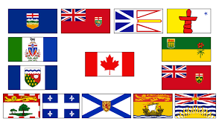
Canada Issues
ROS - RETURN OF SERVICE
Length of service determined by province/discipline
Some residency training positions require you to enter into a return of service (ROS) agreement with the provincial/territorial government. An ROS requires you to practice medicine in a specific area once you complete your residency training. Most often ROS commitments are designed to serve rural or under-serviced communities – that is, communities which are far from major cities. Applicants matched to these positions must be eligible for, and are required to sign the ROS agreement, once matched. A failure to execute the required ROS agreement will void the CaRMS match. Applicants are responsible for contacting the applicable provincial/territorial government to confirm the existence of and the term and contents of any applicable ROS agreement.
Notes:
** Read **

Slide 10
Canadian Applicants to the US (ERAS)
If you are interested in applying to a residency position in the United States then this page is for you.
If you are a Canadian medical graduate and wish to participate in the US match, you must register with ERAS. Please note that the ERAS system is a completely separate system from CaRMS Online.
You may register for both matches and apply to Canadian and US programs, with the understanding that the CaRMS match is run before the NRMP match. You can submit a rank order list to both the NRMP and CaRMS.
Notes:
Canadian students applying to both CaRMS and the US National Resident Matching Program (NRMP) at the same time may have what is colloquially known as “four kicks at the can.”
Chronologically, some students will have the ability to apply to the CaRMS R-1 first iteration, the NRMP Main Match, the NRMP Supplemental Offer and Acceptance Program (SOAP), and the CaRMS R-1 second iteration.
It is important to remember that CaRMS and NRMP communicate and honor one another’s match contracts. This means that matching into a residency program through one matching service will automatically remove you from the other matching service. It is not possible to simultaneously match into both Canada and the United States and then choose between the two.

Slide 11

Canada Issues
Statement of Need (SON)
J-1 VISA
J-2 VISA (spouse/children: can't work in US)
HB1 VISA (pre match green card; highly uncommon)
The J-1 visa application to ECFMG must include a ‘ministry of health letter’ or ‘Statement of Need’ from Health Canada. The Statement of Need / J-1 Visa program is administered by Health Canada with direction from the provinces and territories. To apply please contact Health Canada or go to the Health Canada website.
Do not submit your SON package until after 1:00 pm EST on the day you know where you matched in the USA. PRIOR SUBMISSIONS TO 1:00 EST WILL BE DELETED.
Notes:
Canadian students applying for residency programs in the United States need to be aware of visa requirements.
The B-1 visas issued to students during clinical sciences are only valid during the third and fourth years of the student’s undergraduate medical education. The J-1 visa is the most common visa issued to Canadian students entering US residency. Be sure to thoroughly research residency programs in the United States as not all programs will sponsor visas.

Slide 12


U.S. Residency - Immigration
VISAS:
1 * IMMIGRATION: crossing the border: The Do's & Don’ts
B-1 visa process for 3rd/4th year
J-1 for Residency
H1-B for Residency – very few of these
2 *NEXUS PROGRAM
http://www.cbp.gov/travel/trusted-traveler-programs/nexus
http://www.cbsa-asfc.gc.ca/prog/nexus/menu-eng.html
Notes:
** Read **
If you have not already done so, it is recommended to apply for Canada’s NEXUS program. It is a trusted traveler program run in conjunction with the US Customs and Border Protection.

Slide 13
Canada Issues
Provincial international medical graduate programs:
Alberta Clinical and Surgical Assistant Program
Alberta International Medical Graduate Program
Clinical Skills Assessment and Training Program (Newfoundland and Labrador)
HealthForceOntario Access Centre
IMG-BC Program
Medical Licensure Program for International Medical Graduates (Manitoba)
Saskatchewan International Physician Practice Assessment (SIPPA)
Touchstone Institute (formerly Centre for the Evaluation of Health Professionals Educated Abroad (CEHPEA) (Ontario)
Notes:
The Medical Council of Canada has partnered with the provincial international medical graduate programs.
The MCC grants a qualification in medicine known as the Licentiate of the Medical Council of Canada (LMCC) to medical graduates who have passed the Q1 and Q2 exams and have completed at least 12 months of postgraduate training.
The LMCC is not a license to practice medicine, the authority to issue such is reserved to the medical regulatory authorities of each province.

Slide 14
Canada Issues
CaRMS Webinars
Applicants can now access recordings of past application webinars by logging into CaRMS Online for step by step application process.
FAQs for IMGs
FAQs for CaRMS contract
Notes:
Please visit carms.ca for more detailed information, including thorough frequently asked questions on a variety of topics.

Slide 15
Questions?
Office of Student Professional Development
Eduardo Lopez,
Professional Development Advisor
American University of the Caribbean School of Medicine
901 Ponce de Leon Blvd, Suite 700
Coral Gables, FL 33134
Direct Line: 305-569-8854
Extension: 305-446-0600, ext. 4078854
Email: elopez@aucmed.edu
Website: www.aucmed.edu

